Slide 1
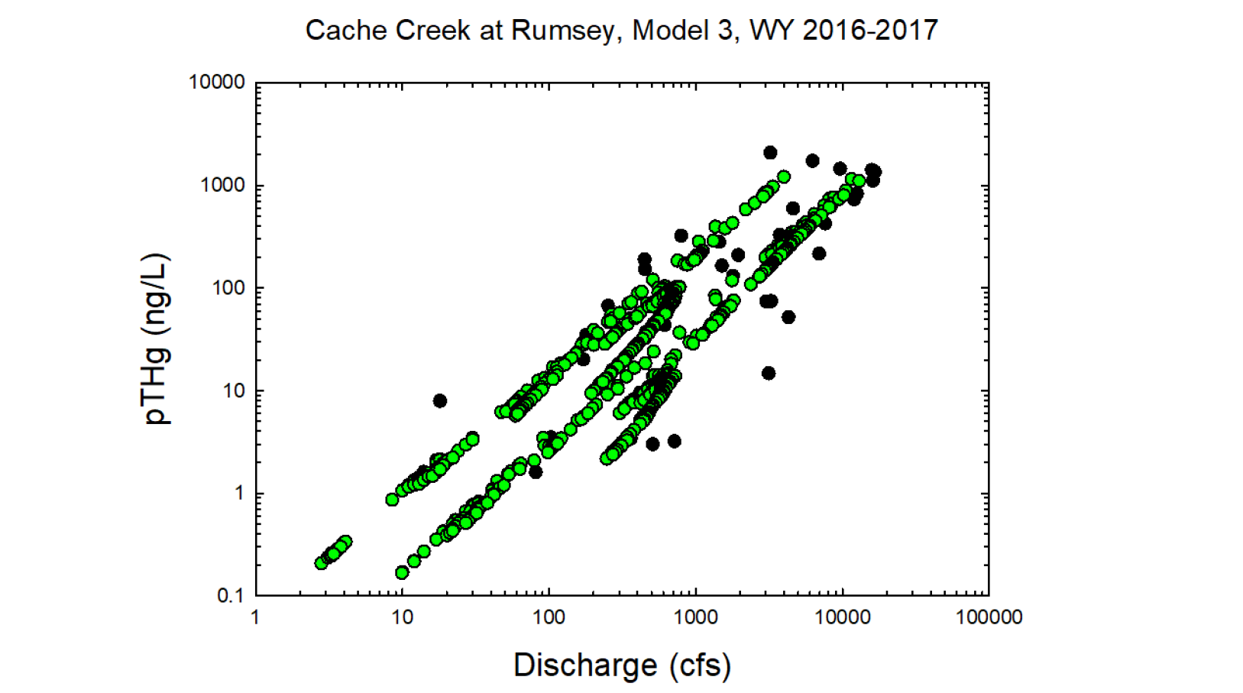
Black circles = Observed values
Green circles = Modeled values

Slide 2
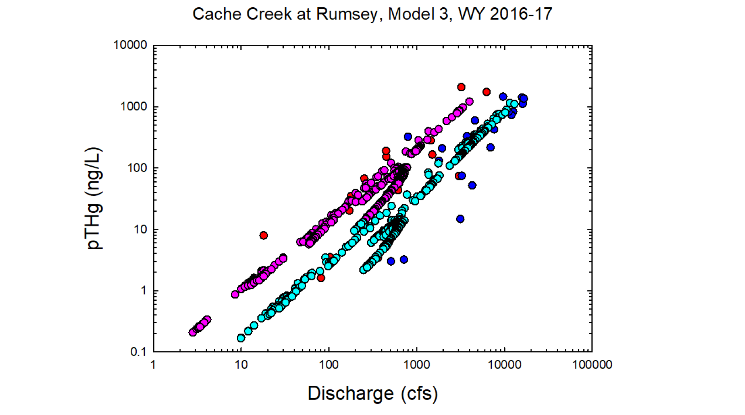
Red = Observed wy2016
Dk. Blue = Observed wy2017
Pink = Modeled wy2016
Lt. Blue= Modeled wy2017

Slide 3
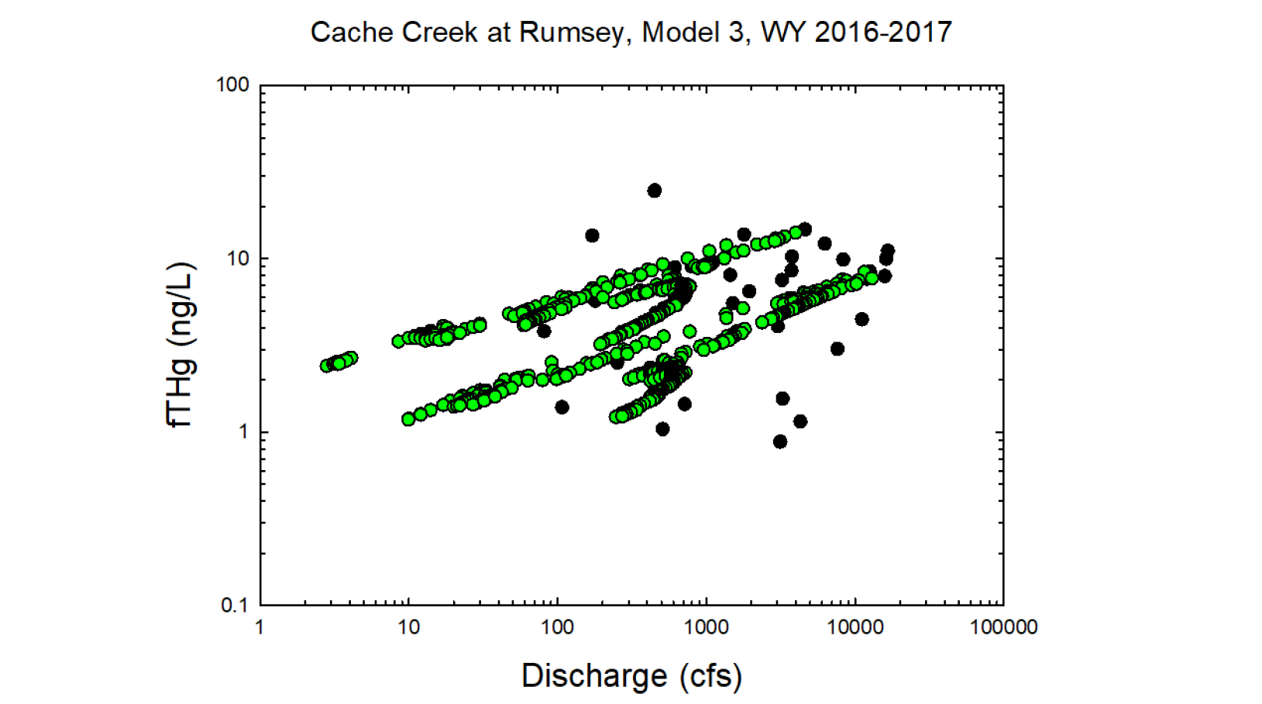
Black circles = Observed values
Green circles = Modeled values

Slide 4
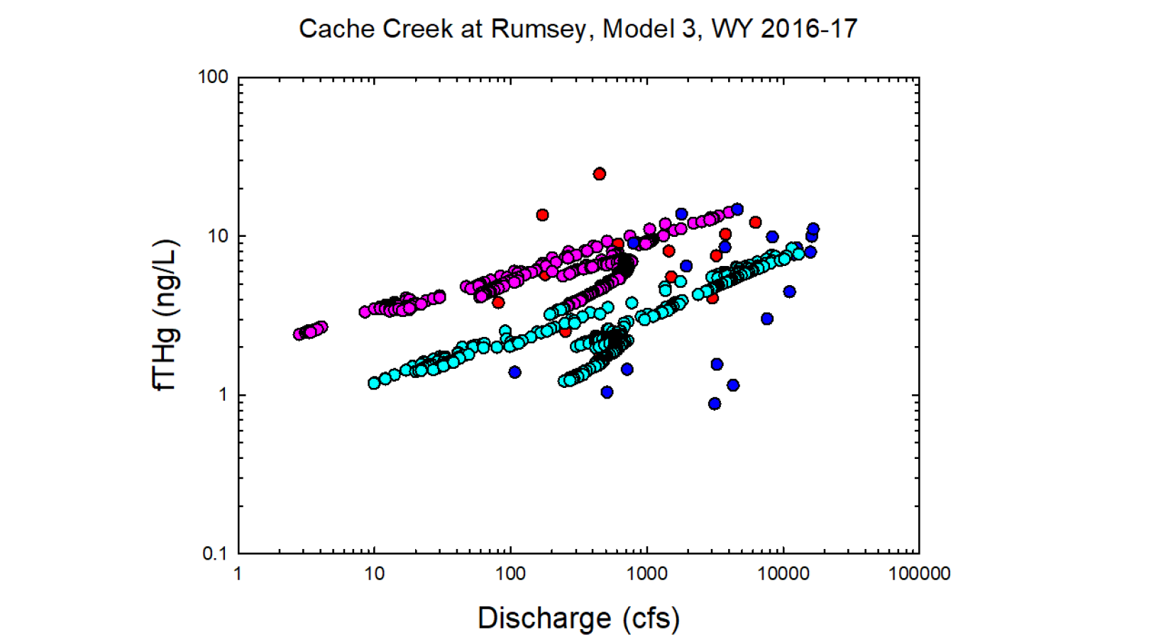
Red = Observed wy2016
Dk. Blue = Observed wy2017
Pink = Modeled wy2016
Lt. Blue= Modeled wy2017

Slide 5
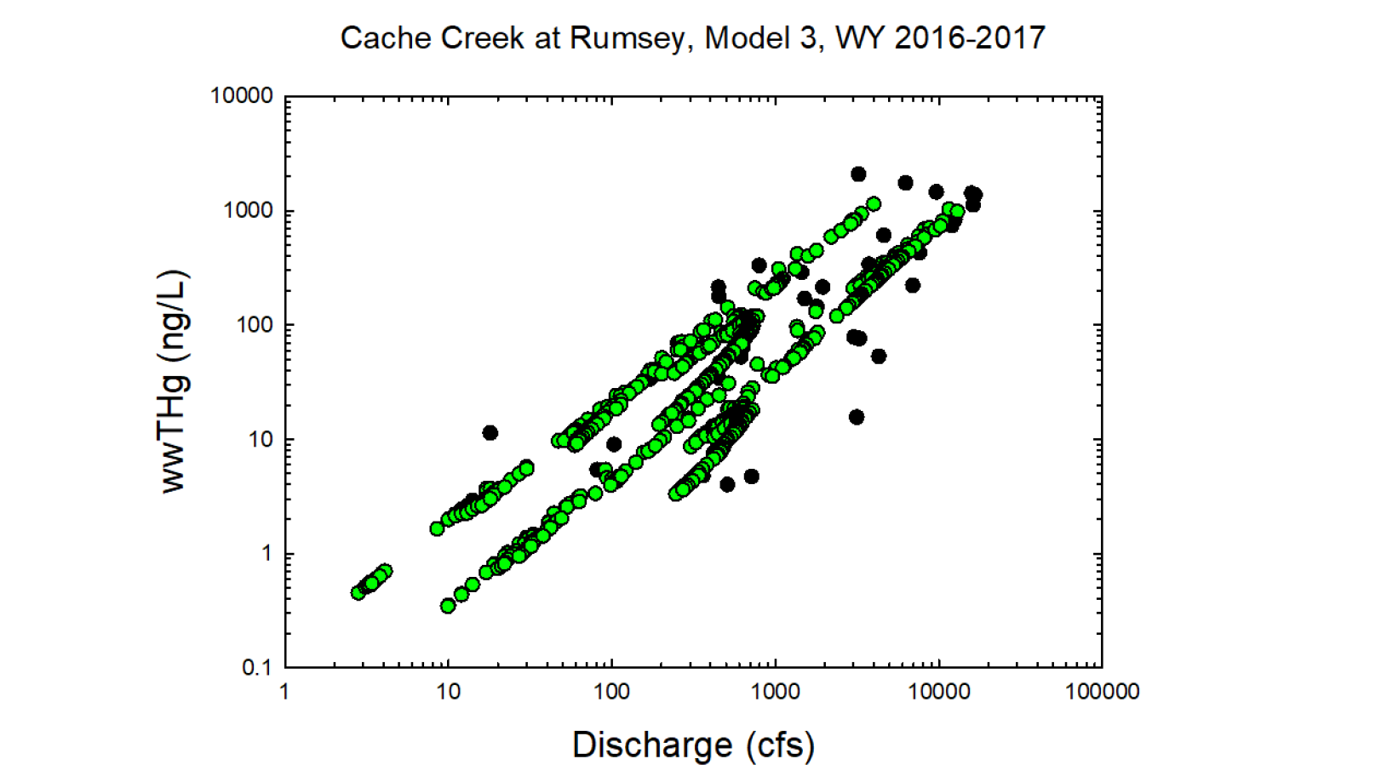
Black circles = Observed values
Green circles = Modeled values

Slide 6
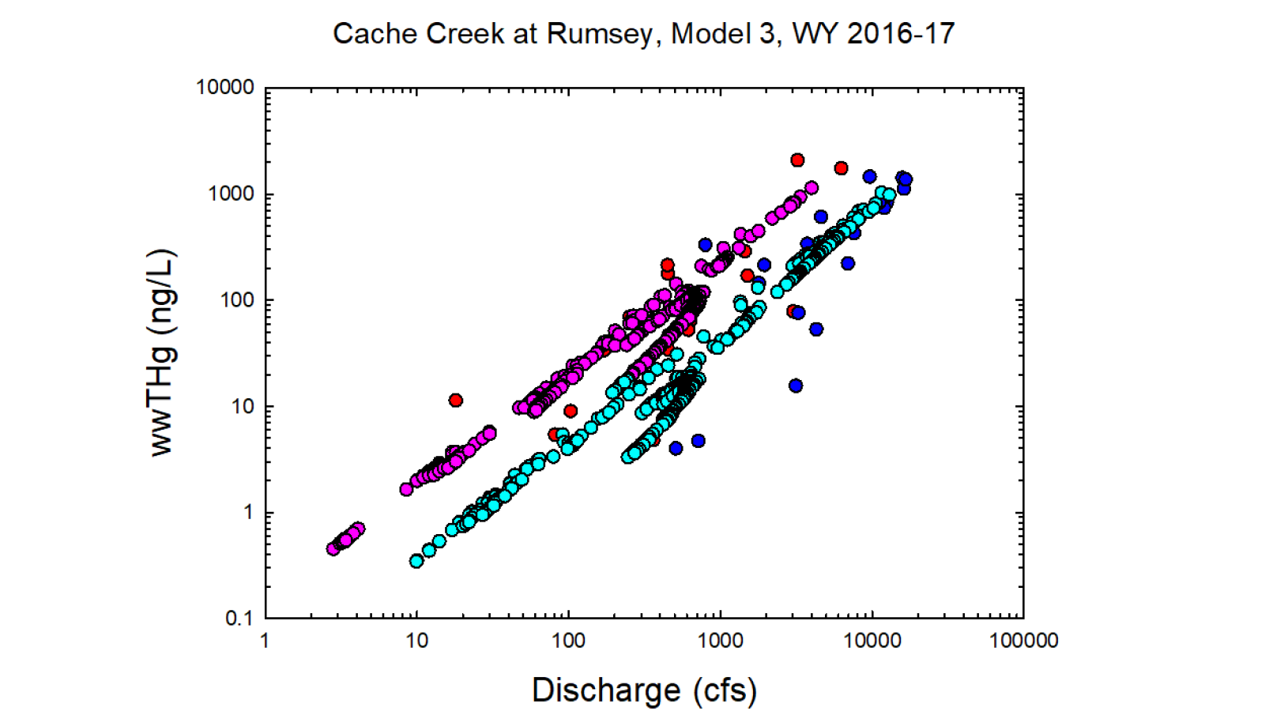
Red = Observed wy2016
Dk. Blue = Observed wy2017
Pink = Modeled wy2016
Lt. Blue= Modeled wy2017

Slide 7
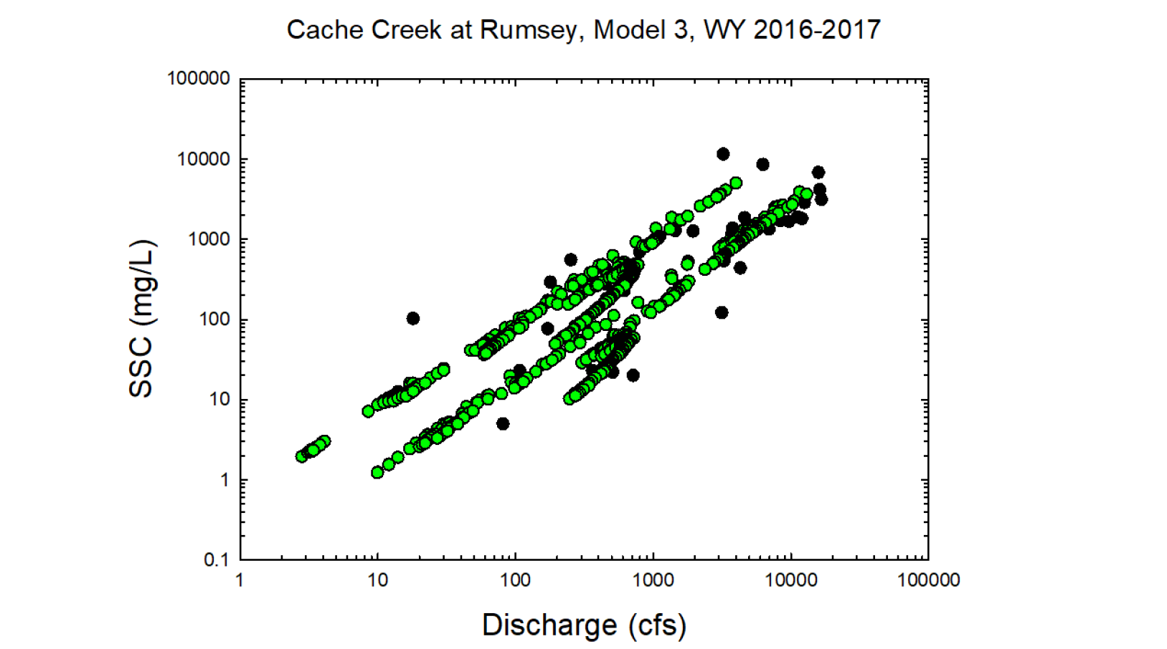
Black circles = Observed values
Green circles = Modeled values

Slide 8
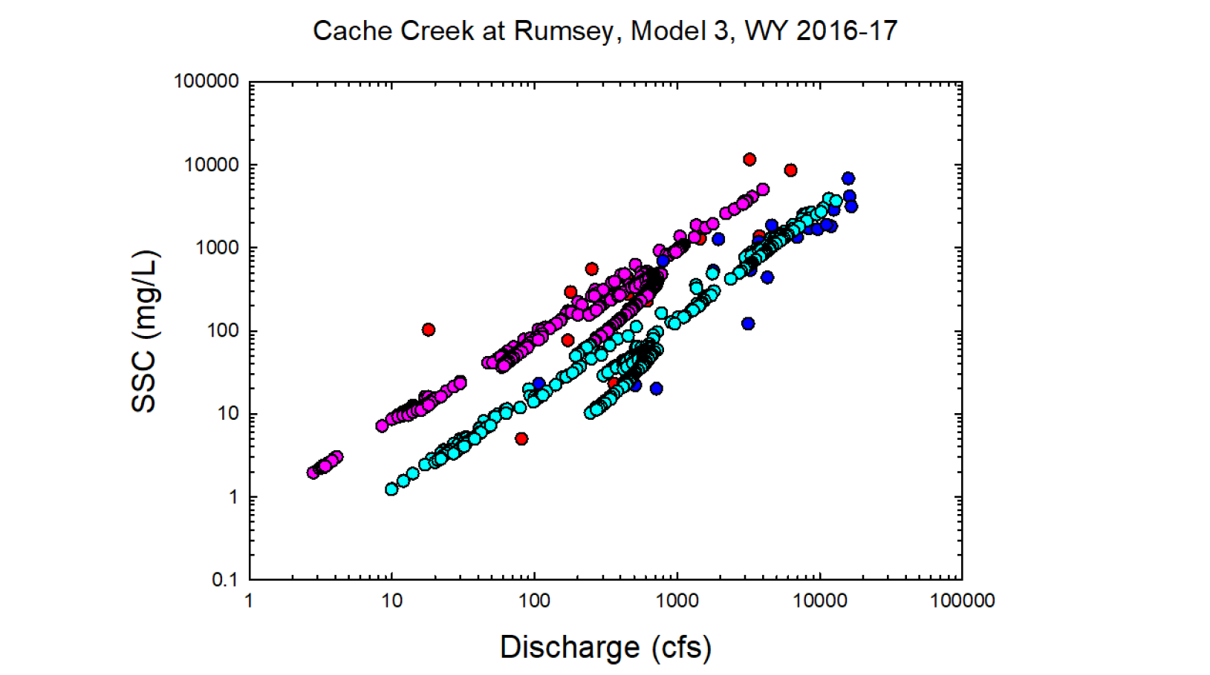
Red = Observed wy2016
Dk. Blue = Observed wy2017
Pink = Modeled wy2016
Lt. Blue= Modeled wy2017

Slide 9
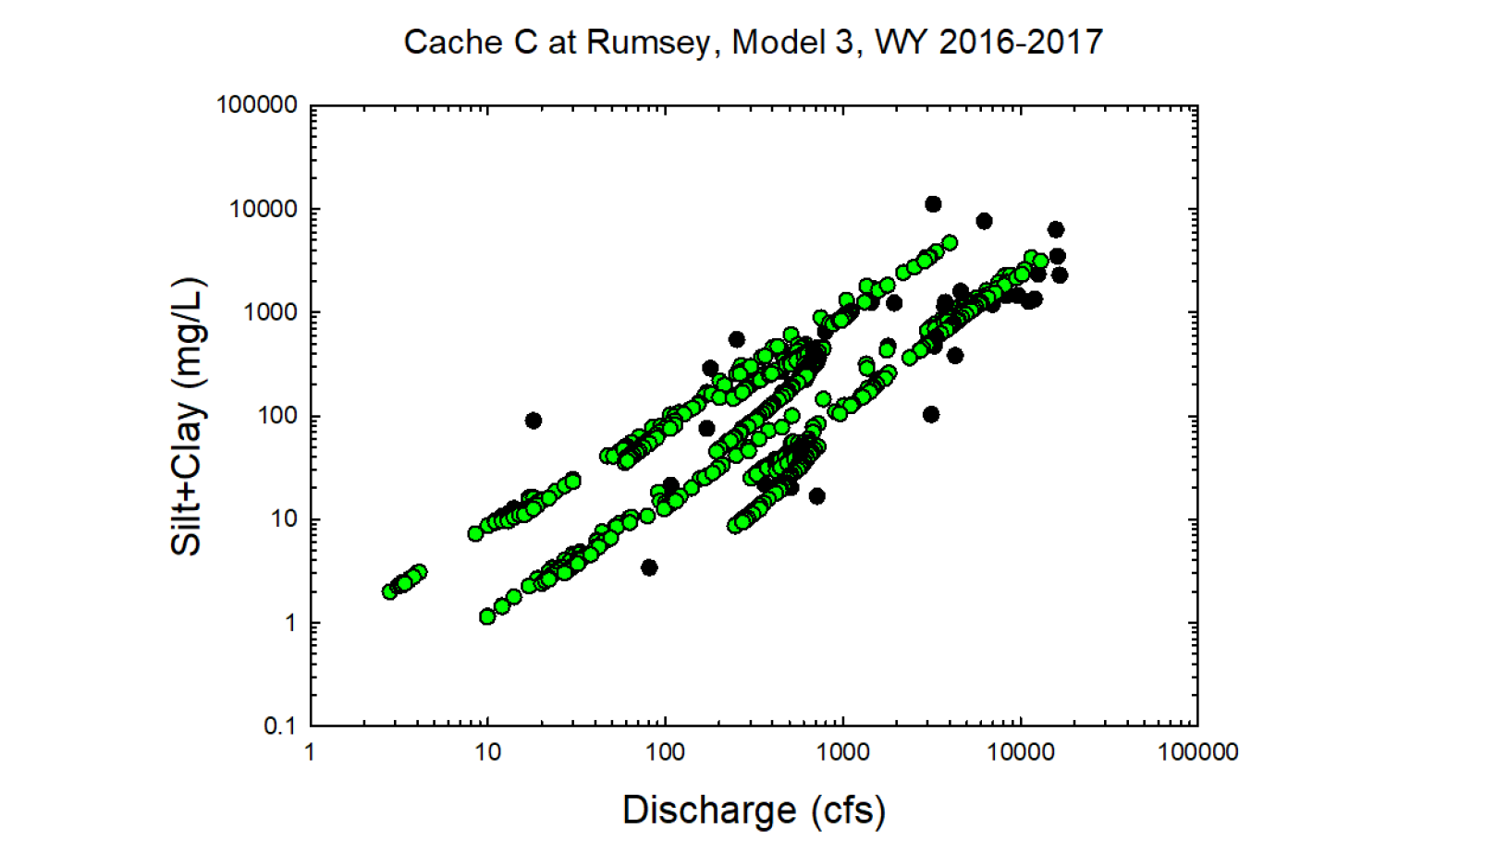
Black circles = Observed values
Green circles = Modeled values

Slide 10
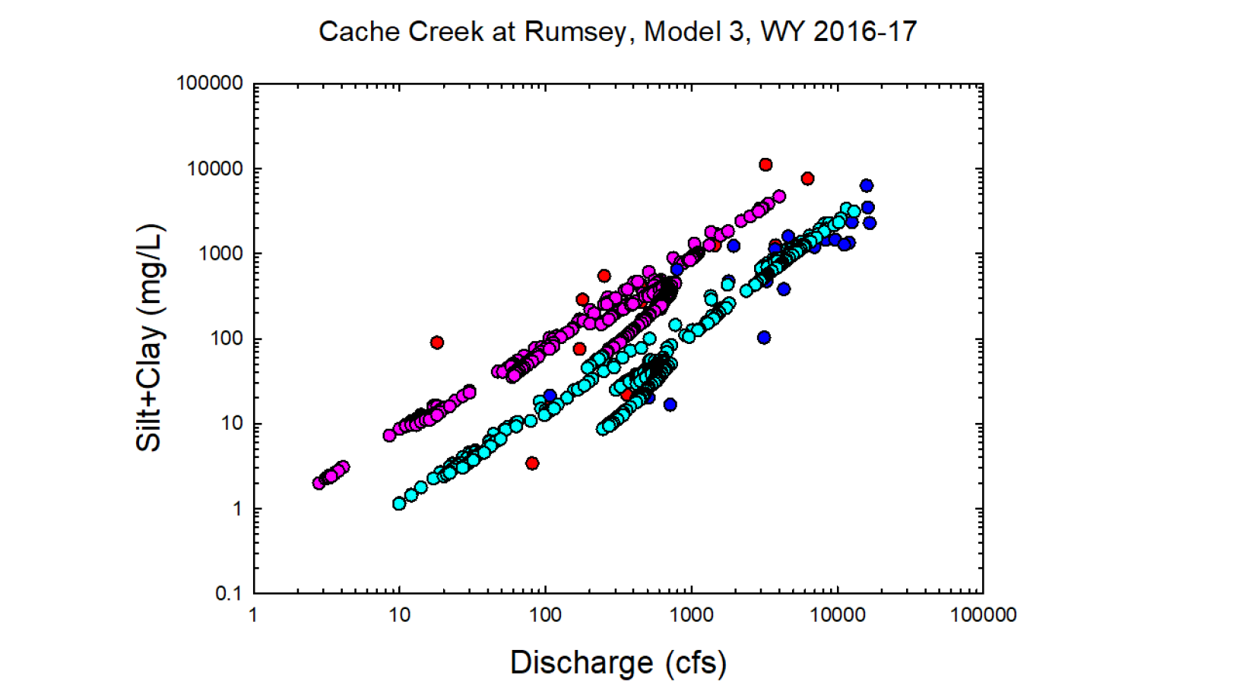
Red = Observed wy2016
Dk. Blue = Observed wy2017
Pink = Modeled wy2016
Lt. Blue= Modeled wy2017

Slide 11
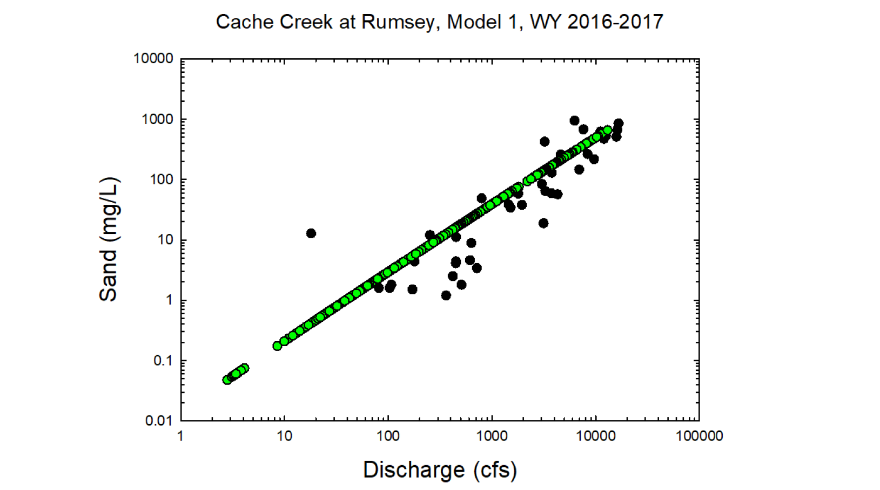
Black circles = Observed values
Green circles = Modeled values

Slide 12
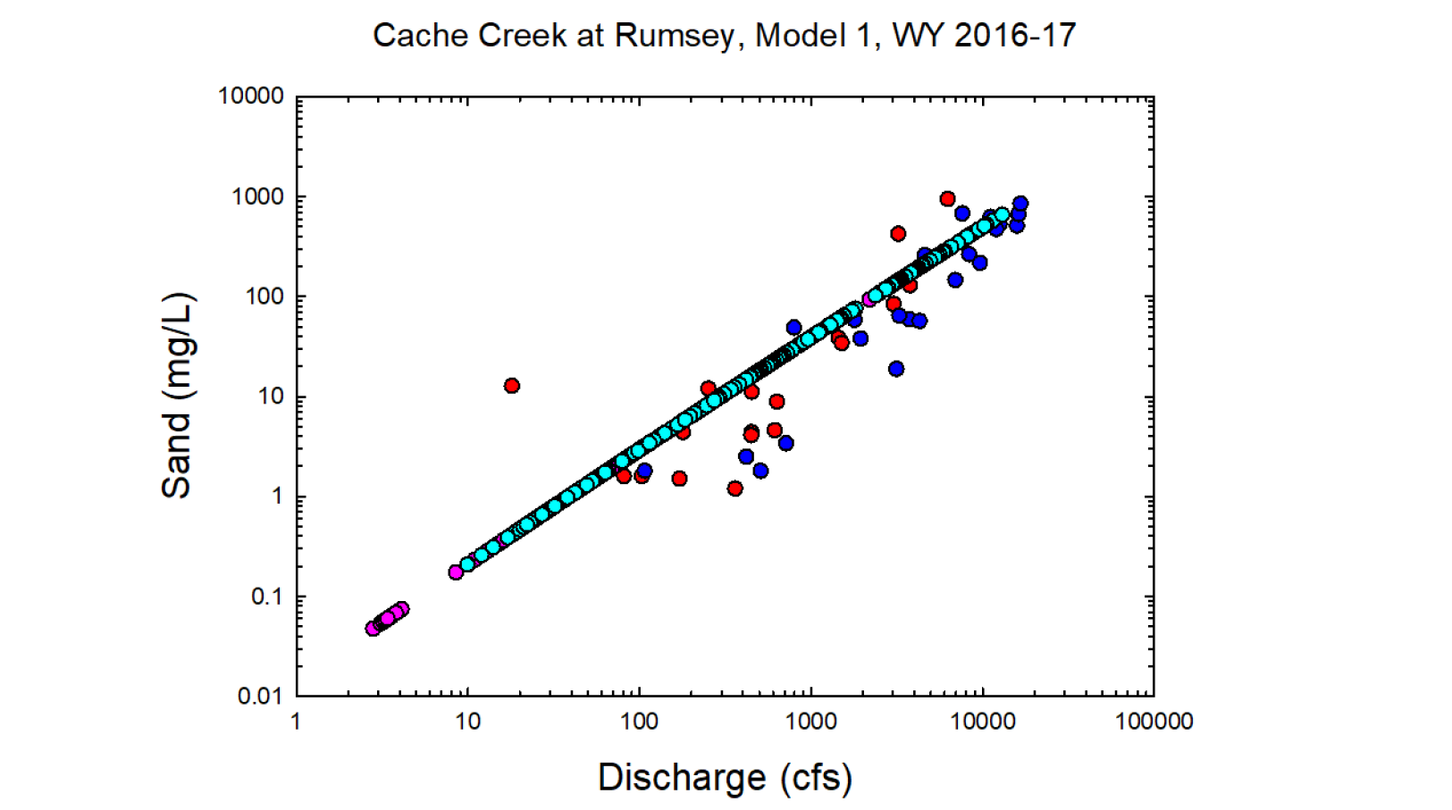
Red = Observed wy2016
Dk. Blue = Observed wy2017
Pink = Modeled wy2016
Lt. Blue= Modeled wy2017

Slide 13
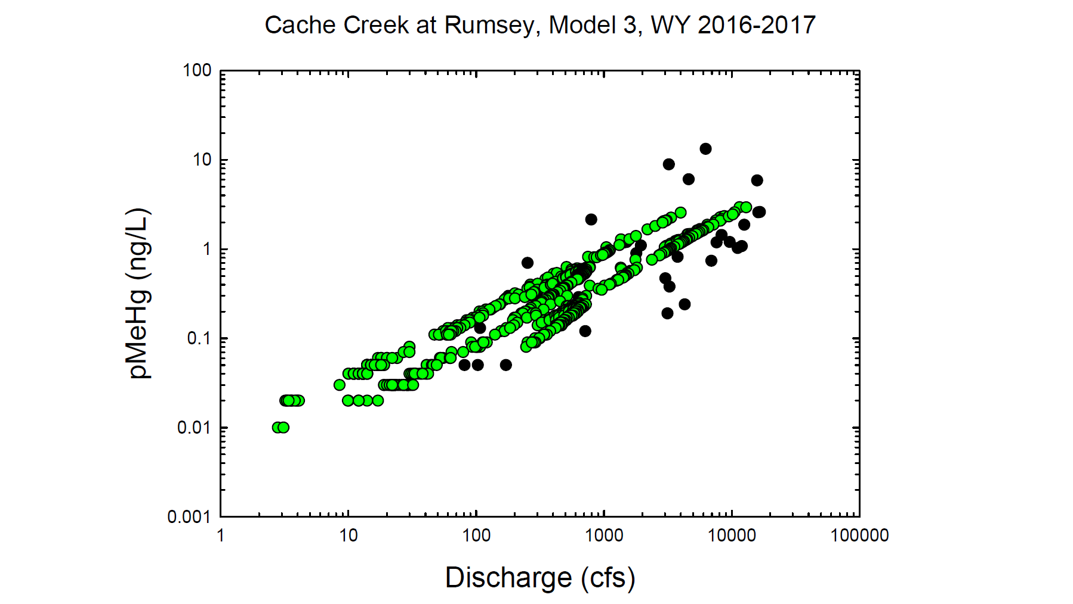
Black circles = Observed values
Green circles = Modeled values

Slide 14
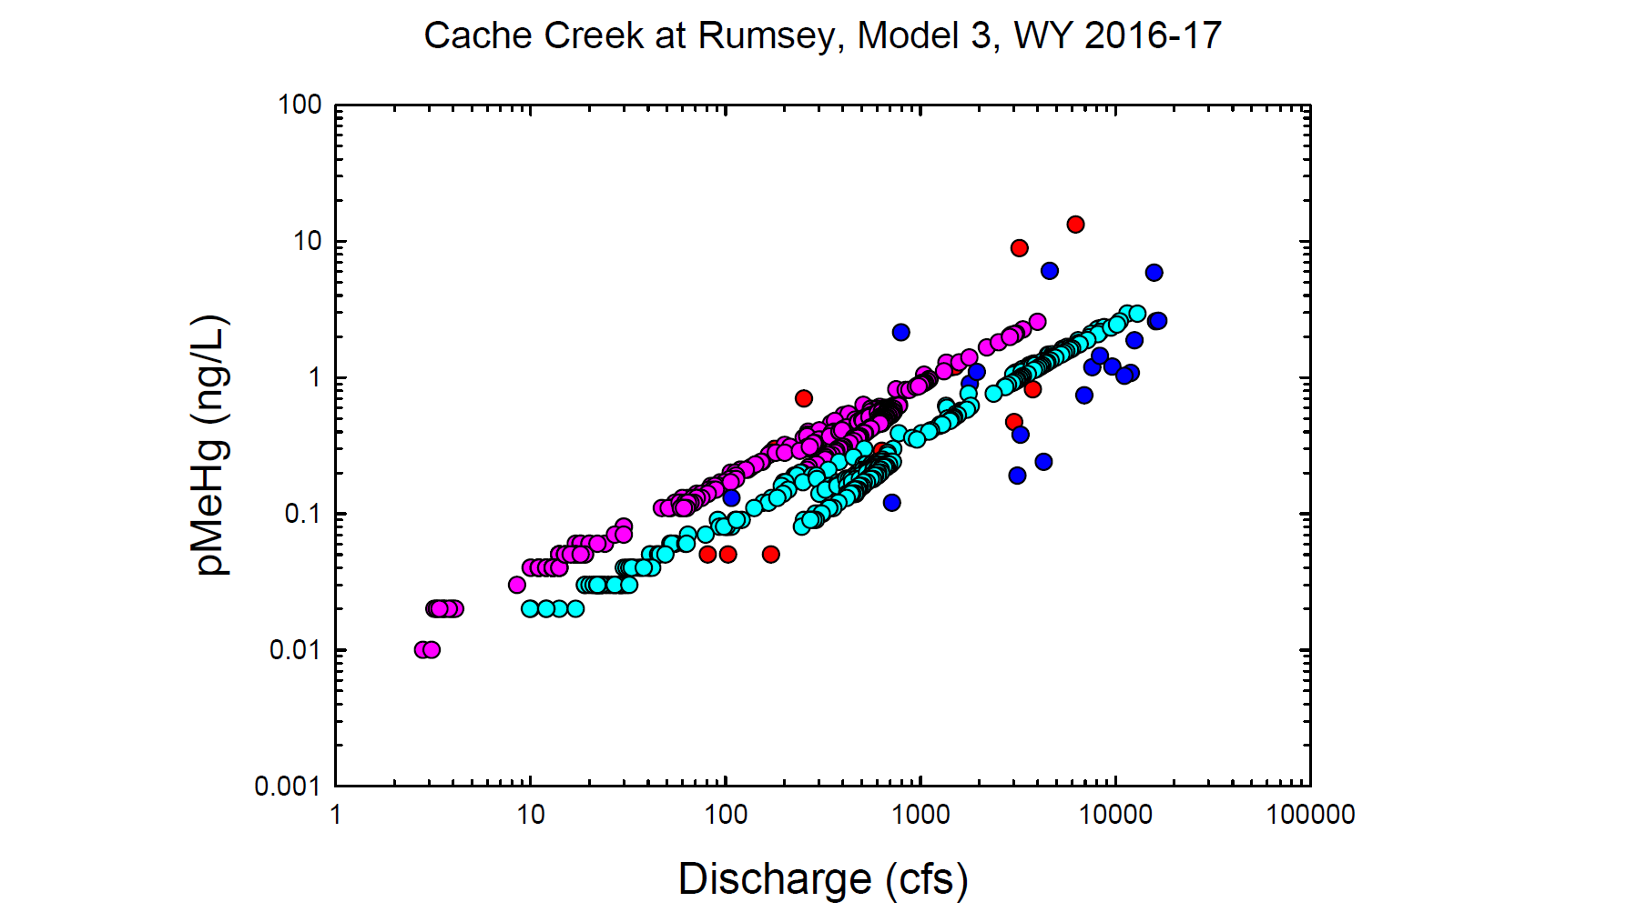
Red = Observed wy2016
Dk. Blue = Observed wy2017
Pink = Modeled wy2016
Lt. Blue= Modeled wy2017

Slide 15
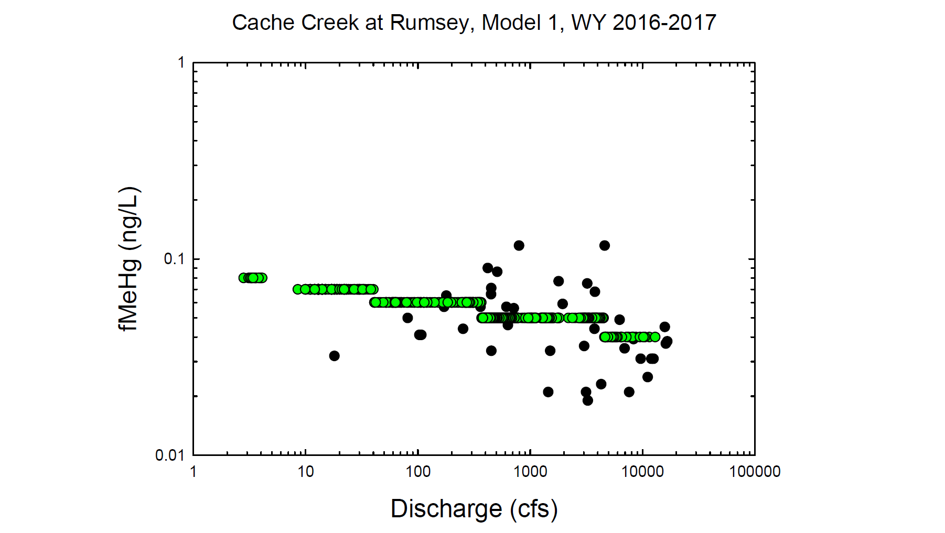
Black circles = Observed values
Green circles = Modeled values

Slide 16
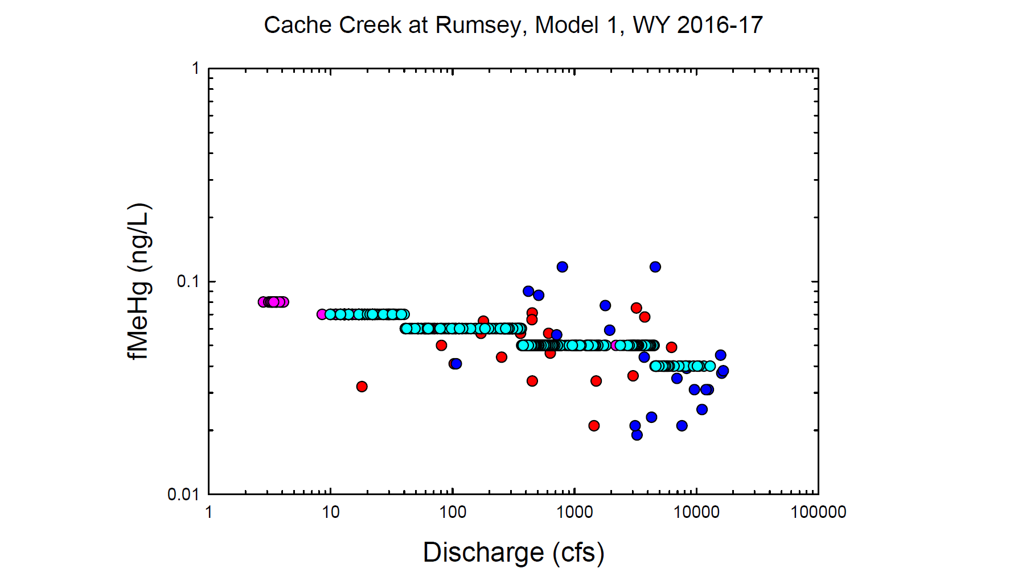
Red = Observed wy2016
Dk. Blue = Observed wy2017
Pink = Modeled wy2016
Lt. Blue= Modeled wy2017

Slide 17
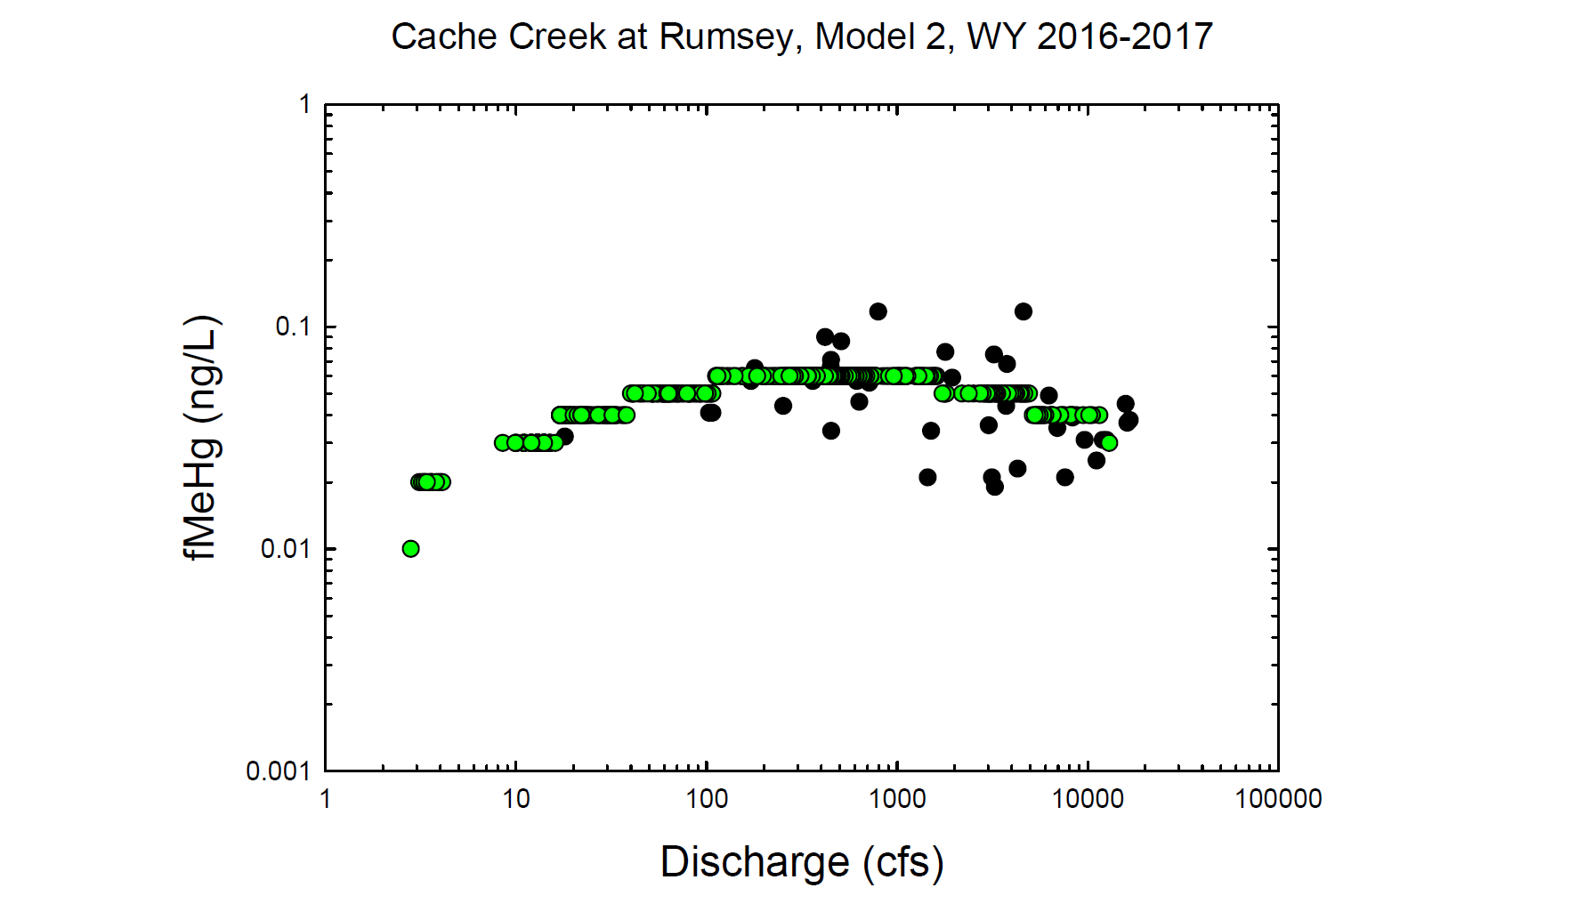
Black circles = Observed values
Green circles = Modeled values

Slide 18
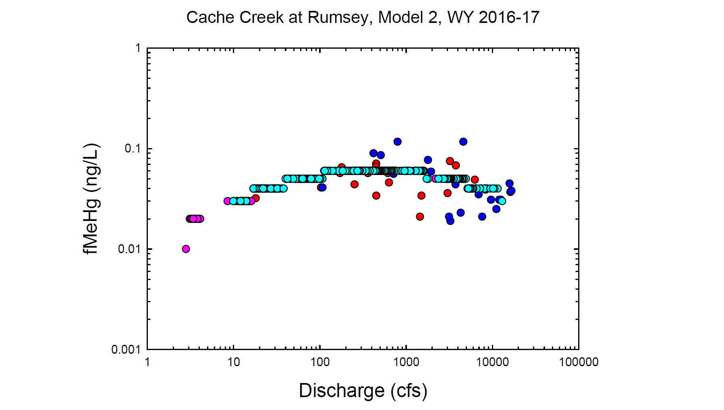
Red = Observed wy2016
Dk. Blue = Observed wy2017
Pink = Modeled wy2016
Lt. Blue= Modeled wy2017

Slide 19
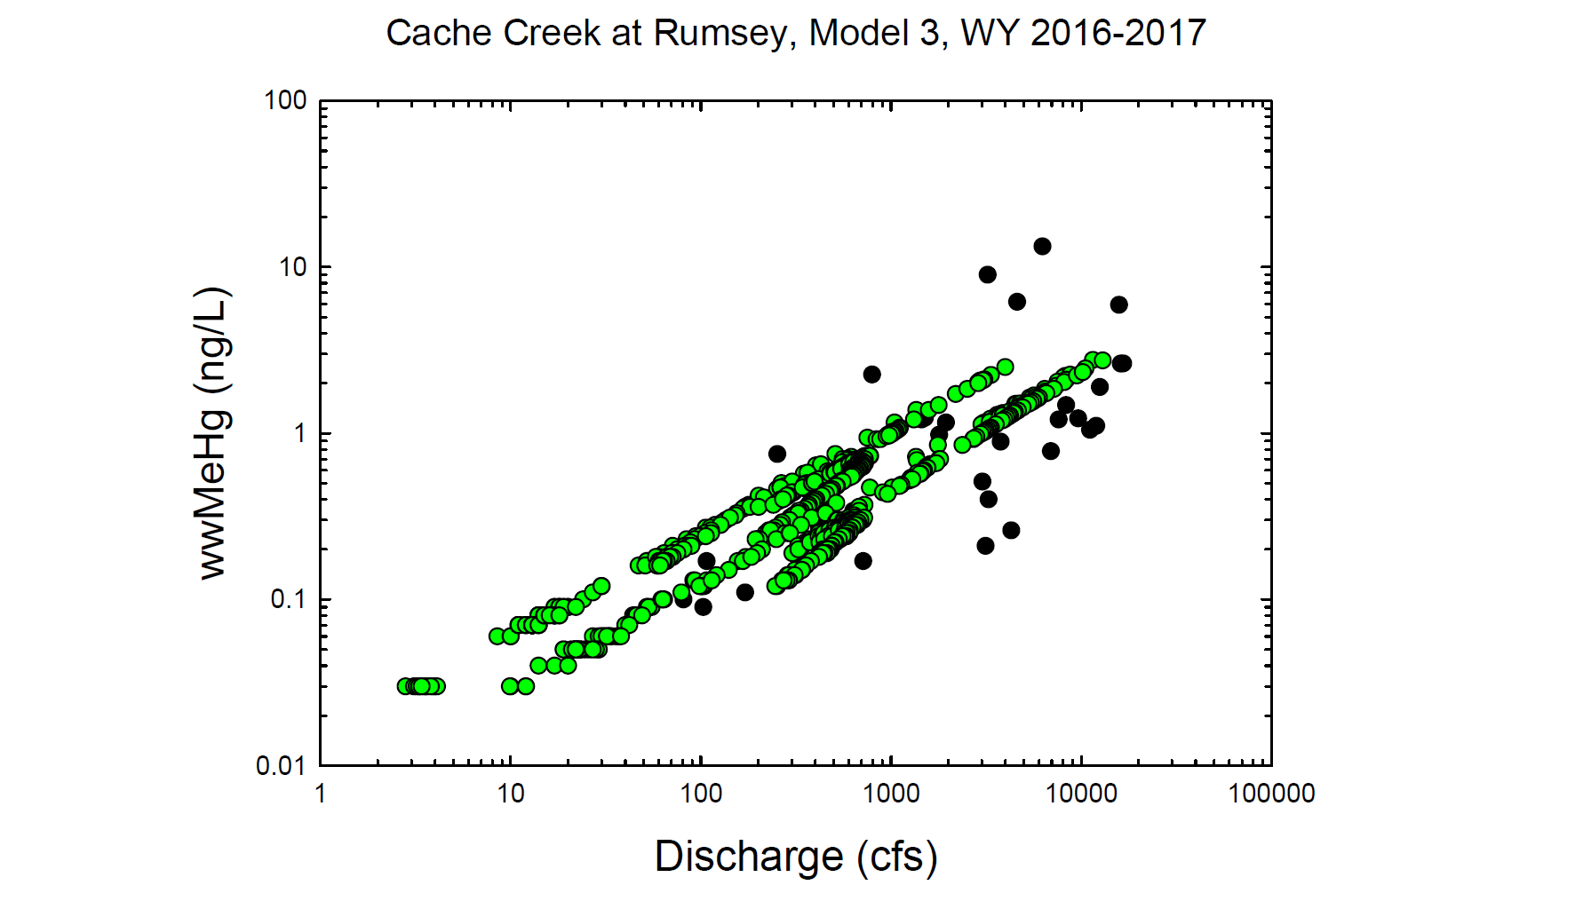
Black circles = Observed values
Green circles = Modeled values

Slide 20
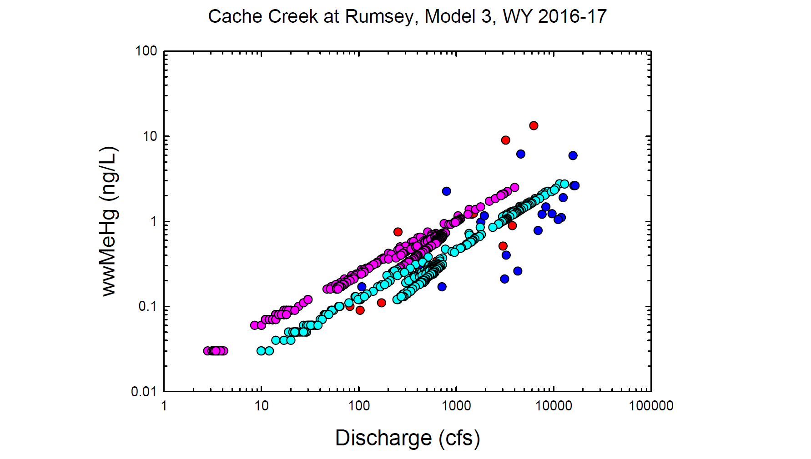
Red = Observed wy2016
Dk. Blue = Observed wy2017
Pink = Modeled wy2016
Lt. Blue= Modeled wy2017

